Slide 1

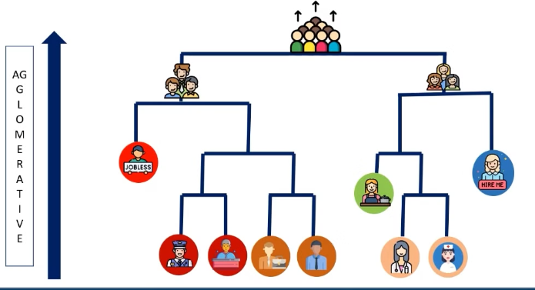

Machine Learning
Lecture 14: Hierarchical Clustering
Instructor: Dr. Shazia Saqib

Slide 2

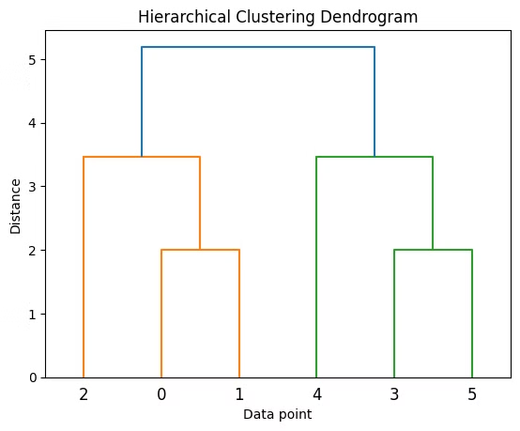
Introduction to Hierarchical Clustering
Unsupervised learning method
Builds clusters in hierarchical tree-like structure
Forms clusters by merging or splitting data points

Slide 3
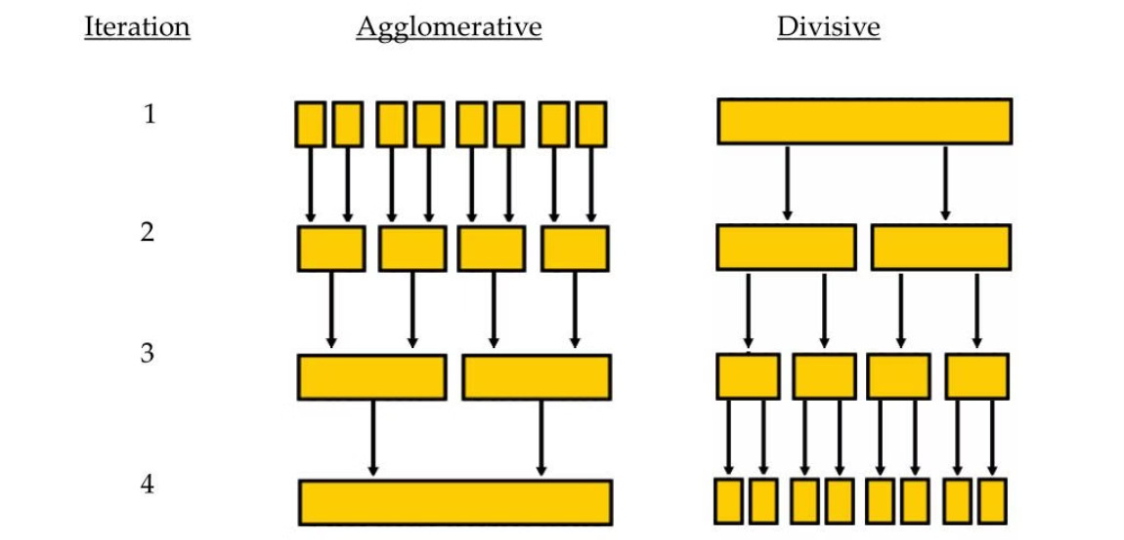
Types of Hierarchical Clustering
Agglomerative Clustering (Bottom-Up)
Divisive Clustering (Top-Down)
Starts with each data point as a separate cluster.
Starts with all data points in a single cluster.
Iteratively merges the closest clusters until a single cluster remains or a desired number of clusters is reached
Recursively splits clusters into smaller ones based on dissimilarity.
Less common and computationally expensive compared to agglomerative clustering.

Slide 4




How Hierarchical Clustering Works
Agglomerative
Merges smaller clusters
Divisive
Splits larger clusters
Step-by-step
Builds clusters progressively

Slide 5
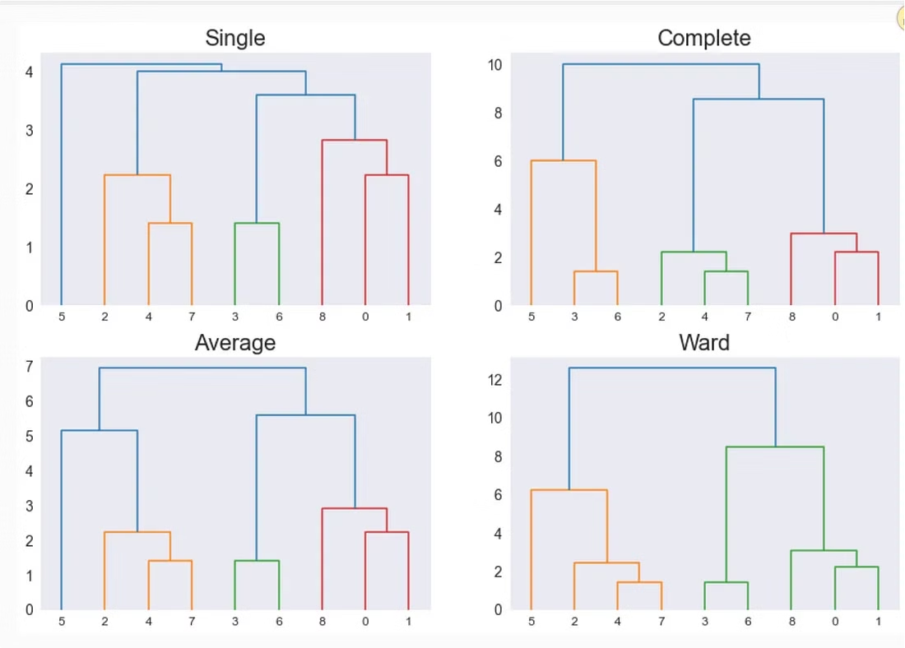
Linkage Criteria Progression
1
Single Linkage
Simplest method - measures distance between closest points between clusters
2
Complete Linkage
More comprehensive - considers farthest points between clusters
3
Average Linkage
Advanced approach - calculates average distance between all points in clusters
4
Ward's Method
Most sophisticated - minimizes variance within clusters for optimal grouping

Slide 6



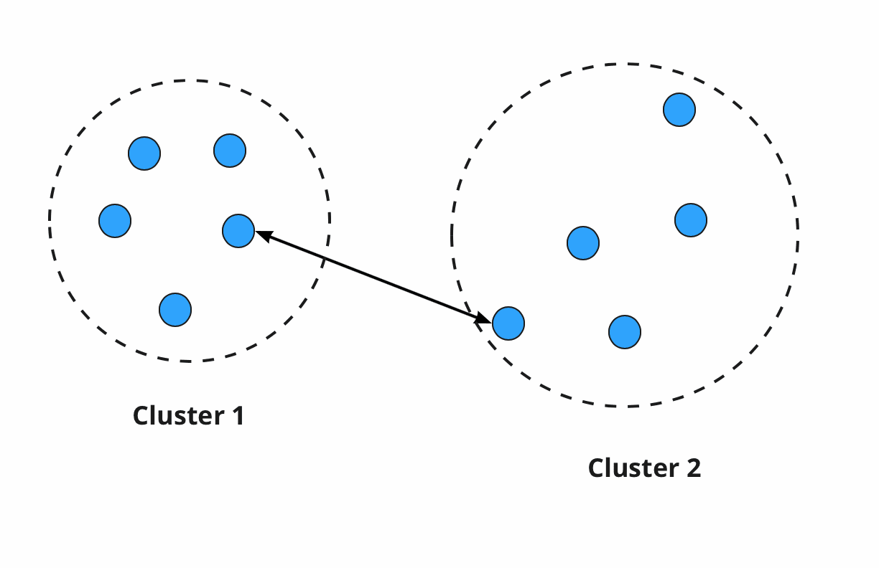
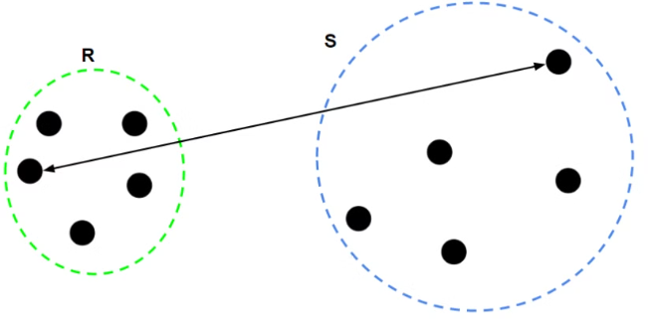
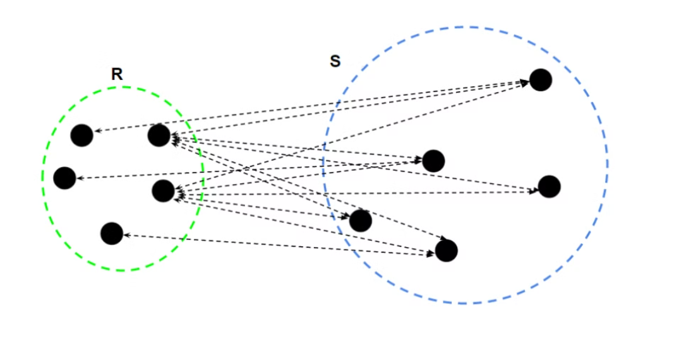
Linkage Methods Overview
Single Linkage
Complete Linkage
Average Linkage
Shortest distance between clusters
Longest distance between clusters
Average distance between clusters

Slide 7
Single Linkage Method
Definition
Measurement
Shortest distance between any pair of points
Considers closest points in two clusters
Characteristic
Sensitive to outliers

Slide 8
Complete Linkage Method
Definition
Measurement Process
Result
Longest distance between any pair of points
Forms compact clusters
Considers farthest points in two clusters

Slide 9
Average Linkage Method
1
2
3
Definition
Measurement
Characteristic
Average distance between all pairs of points
Considers all points in both clusters
Balances single and complete linkage

Slide 10


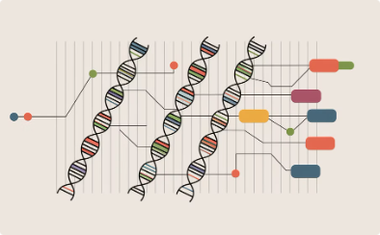

Real-World Applications
Customer Segmentation
Document Organization
Genetic Analysis
Image Segmentation
Groups similar genes together. Helps scientists understand how genes are related to each other in biology research.
Splits pictures into different parts based on what looks similar. Helps computers identify different objects in images.
Groups similar customers together based on their shopping habits and basic information. Helps companies serve different types of customers better.
Sorts similar documents into groups. Makes it easy to find and manage large collections of files.

Slide 11



Advantages of Hierarchical Clustering
Flexibility
Hierarchy
Visualization
Eliminates the need to specify the number of clusters in advance, allowing the algorithm to discover natural groupings in the data
Creates an intuitive tree-like structure that reveals relationships between clusters at different levels of granularity
Provides clear visual representation through dendrograms, making cluster interpretation and analysis straightforward

Slide 12



Limitations of Hierarchical Clustering
Sensitivity
Computational Cost
Irreversibility
Highly susceptible to outliers and noise in datasets, potentially leading to distorted cluster formations
Requires significant processing power and time with O(n²) complexity, making it impractical for large datasets
Once clusters are merged or split, decisions cannot be undone, making the algorithm unable to correct earlier suboptimal choices

Slide 13
Transition to Practical: Performing Hierarchical Clustering
1
Next Steps
2
Focus
3
Goal
Practical session using Python and Scikit-learn
Data preparation and implementation
Hands-on experience with clustering

Slide 14




Practical Steps: Data Preparation
Load Data
Handle Missing Values
Normalize Features
Select Features
Import data from various sources like CSV files, databases, or APIs into your analysis environment
Transform variables to a common scale using techniques like min-max scaling or standardization
Identify and extract the most relevant variables that will contribute to your analysis goals
Address gaps in data through imputation, removal, or appropriate statistical methods
Notes:
Data preparation is a critical first step in any data analysis or machine learning project The goal is to transform raw data into a clean, structured format that can be effectively analyzed Let's walk through the key steps in the data preparation process First, we need to load the data into our analysis environment. This involves importing the dataset, whether it's a CSV file, database, or other format It's important to understand the structure and contents of the data at this stage Next, we need to handle any missing values in the data. This could involve techniques like imputation, dropping rows/columns, or other data cleaning methods Choosing the right approach depends on the nature of the missing data and the goals of the analysis After cleaning, we'll want to normalize the features in the data. This helps ensure that all variables are on a similar scale, which is important for many machine learning algorithms Common normalization techniques include min-max scaling, z-score normalization, and log transformation Finally, we'll select the most relevant features for our analysis or modeling. This feature engineering step can have a big impact on the performance of our models We might use techniques like correlation analysis, recursive feature elimination, or domain expertise to identify the most informative attributes

Slide 15
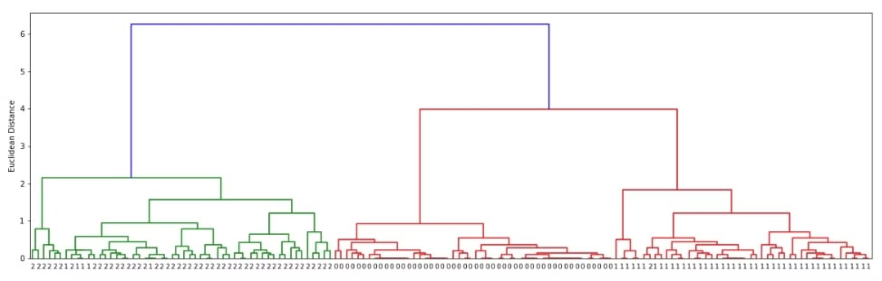
Implementing Hierarchical Clustering
1
2
3
4
Import Libraries
Compute Linkage Matrix
Generate Dendrogram
Analyze Clusters
Interpret results
Scikit-learn, NumPy, Matplotlib
Use linkage() function
Visualize cluster hierarchy

Slide 16




Summary
A comprehensive overview of hierarchical clustering approaches and applications:
Clustering Approaches
Linkage Methods
Agglomerative (bottom-up) starts with individual points and merges, while Divisive (top-down) starts with one cluster and splits
Single, complete, average, and Ward's methods determine how clusters merge together
Visualization & Features
Real-World Applications
Dendrogram tree diagrams visualize hierarchical relationships without requiring pre-defined number of clusters
Used in bioinformatics, document clustering, market segmentation, and social network analysis

